Slide 1

Hostel Management System

Slide 2
Project Overview
‘Hostel management system’ provides a detailed view of how the students records, room allocation , vacating or changing process and staff details. The hostel management system also equipped with some special supports from staff for helping hostel administration.
Each record in the system has unique identity and it can be searched by an unique id. The basic idea behind developing this project is to make easy accommodation and easy calculation process for the Hostel Management.
Use of this project in the hostel reduce the paper work in the hostel and it can be a easy maintainable system for the administration.

Slide 3
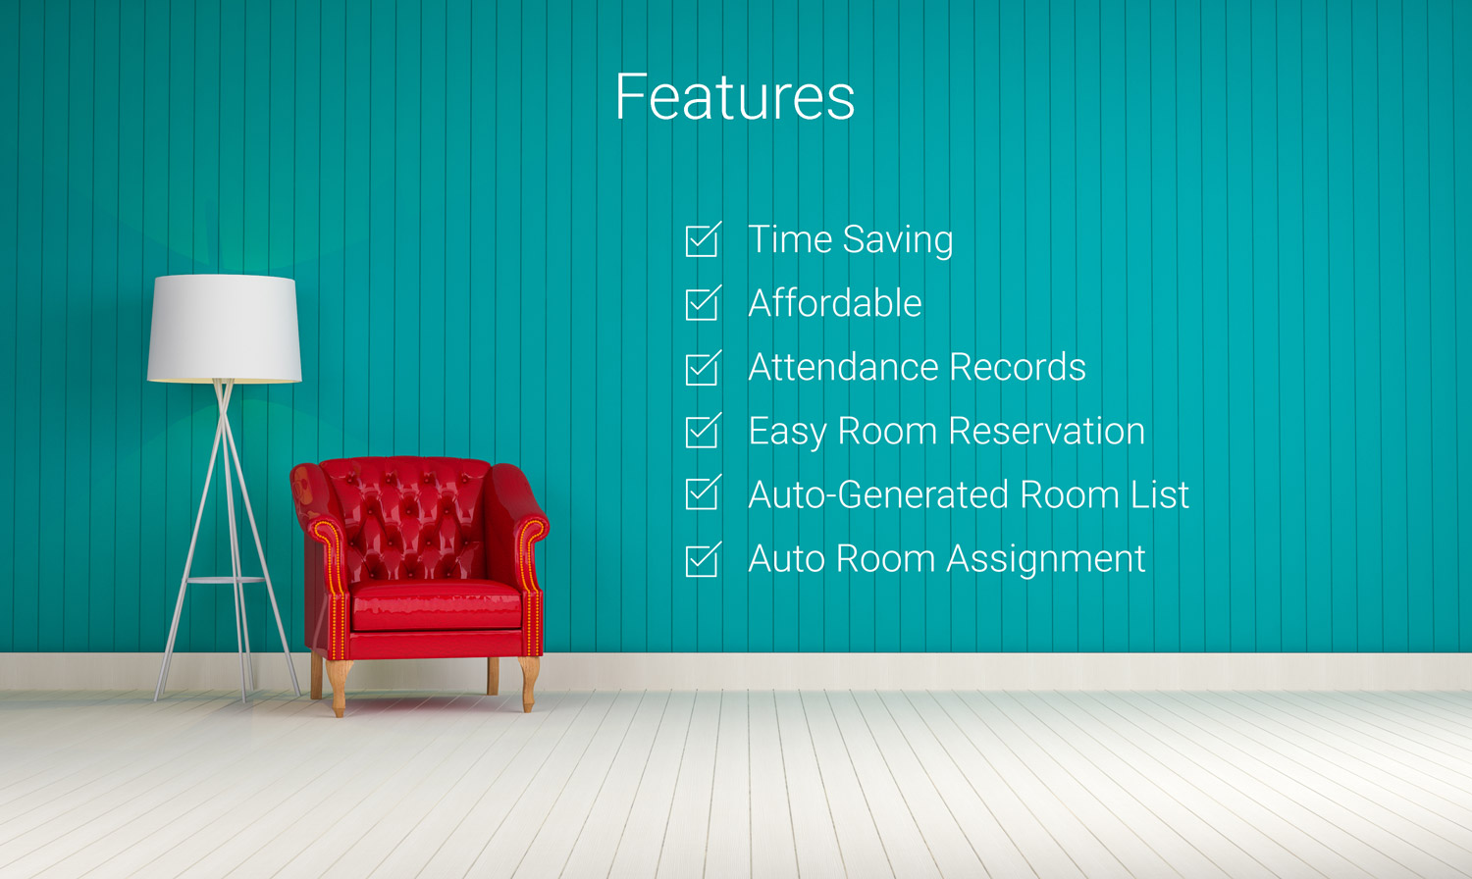
Features for Hostel Management System

Slide 4

Design and Implementation Constraints

Slide 5
User Interfaces
Students
Hostel staff
Administrator

Slide 6
Hardware Interfaces
Computer- it will be required for to open the website and use the software.
Smartphone
Internet

Slide 7
Software Interfaces
A SQL Database Server will be required to store and retrieve data
1
A web browser will be required to open the website.
2

Slide 8
Diagrams
1. ER- Diagram
2. Use Case Diagram
3. Sequence Diagram
4. Class Diagram

Slide 9
ER-Diagram

Slide 10
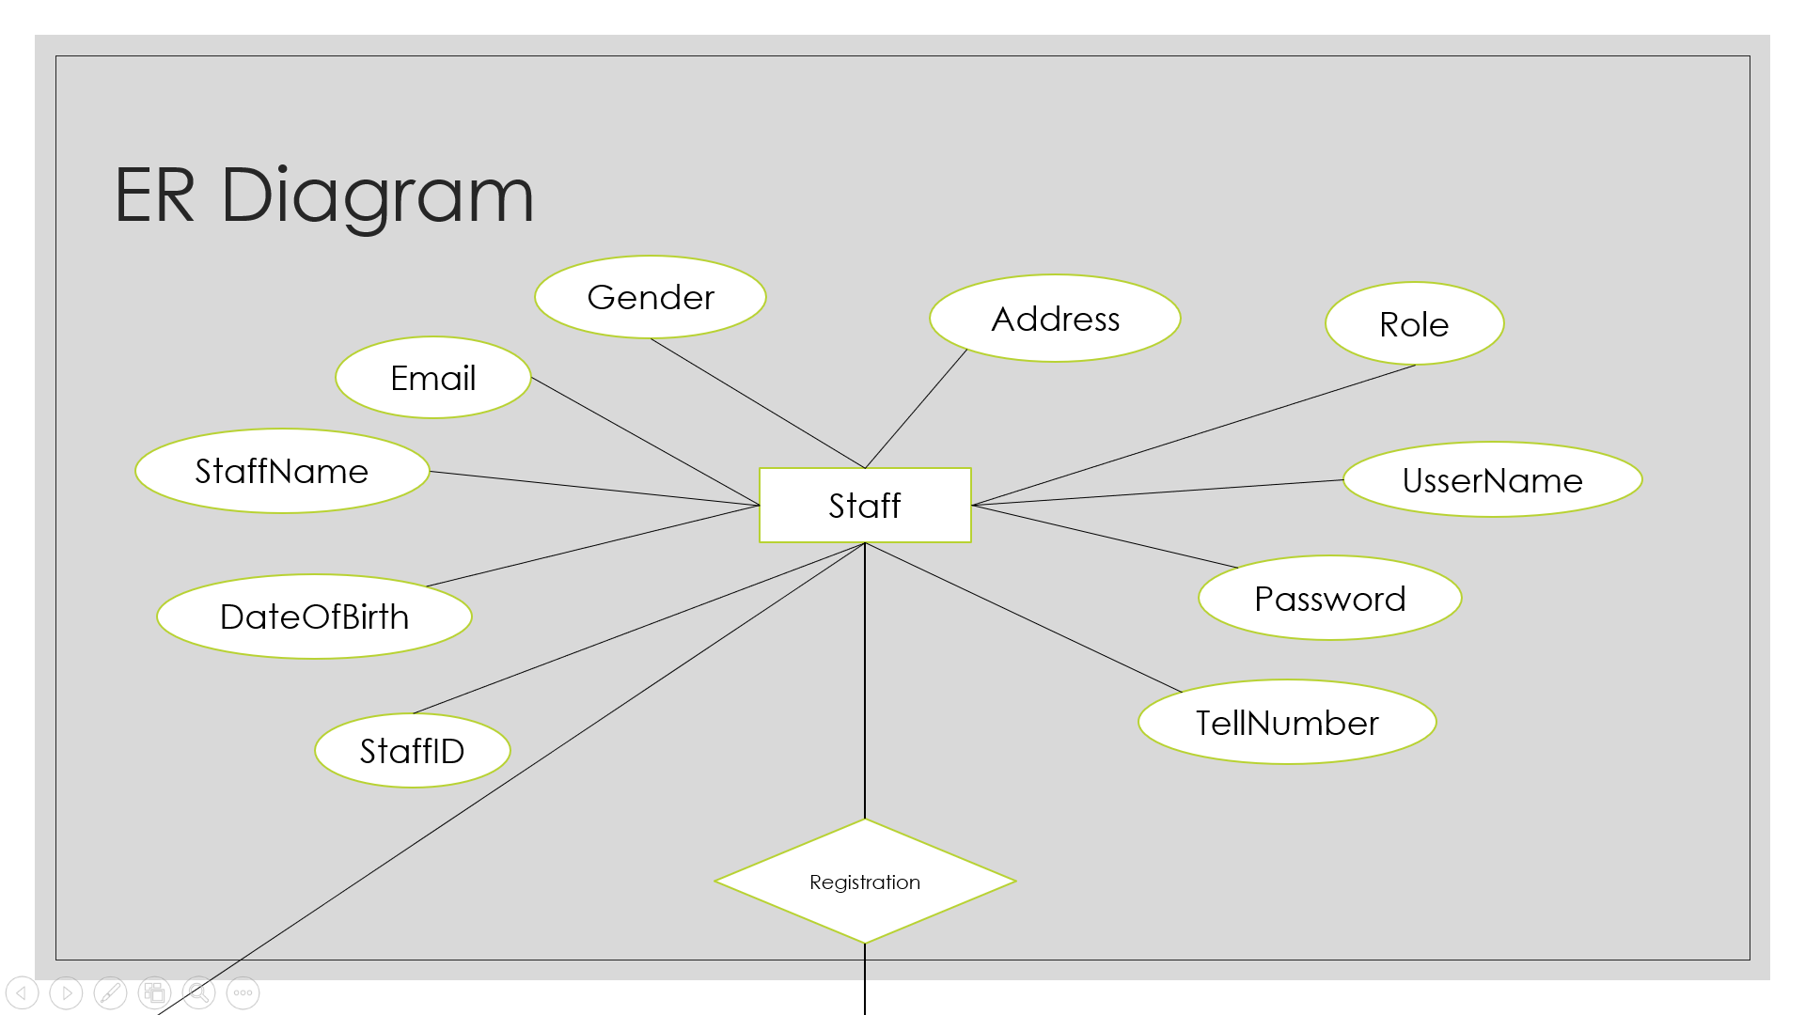

Slide 11
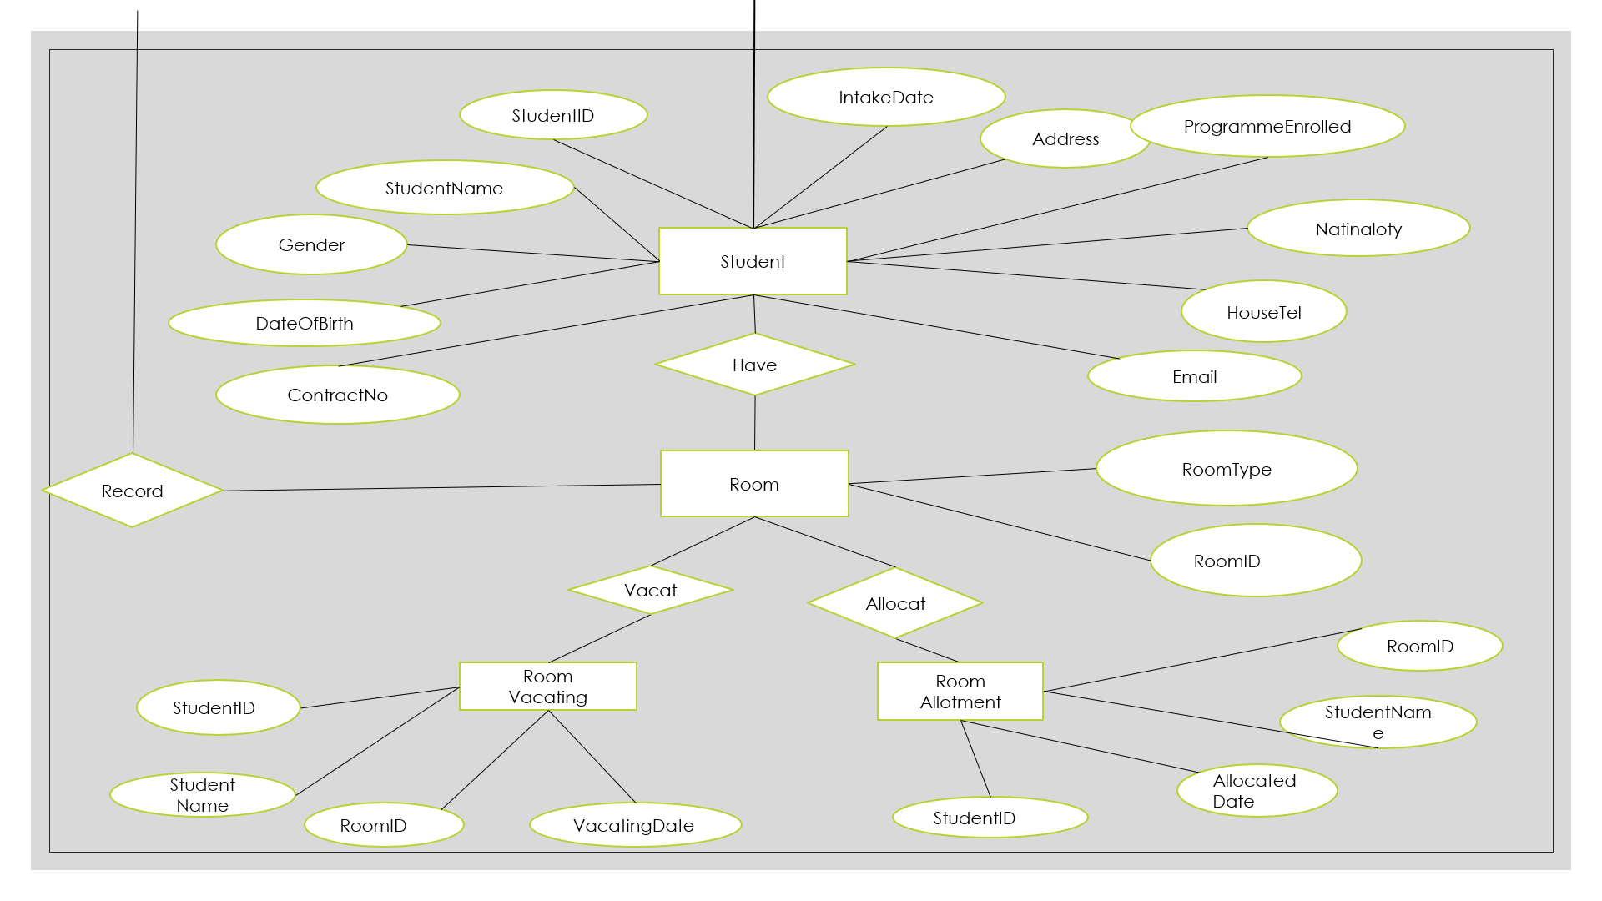

Slide 12
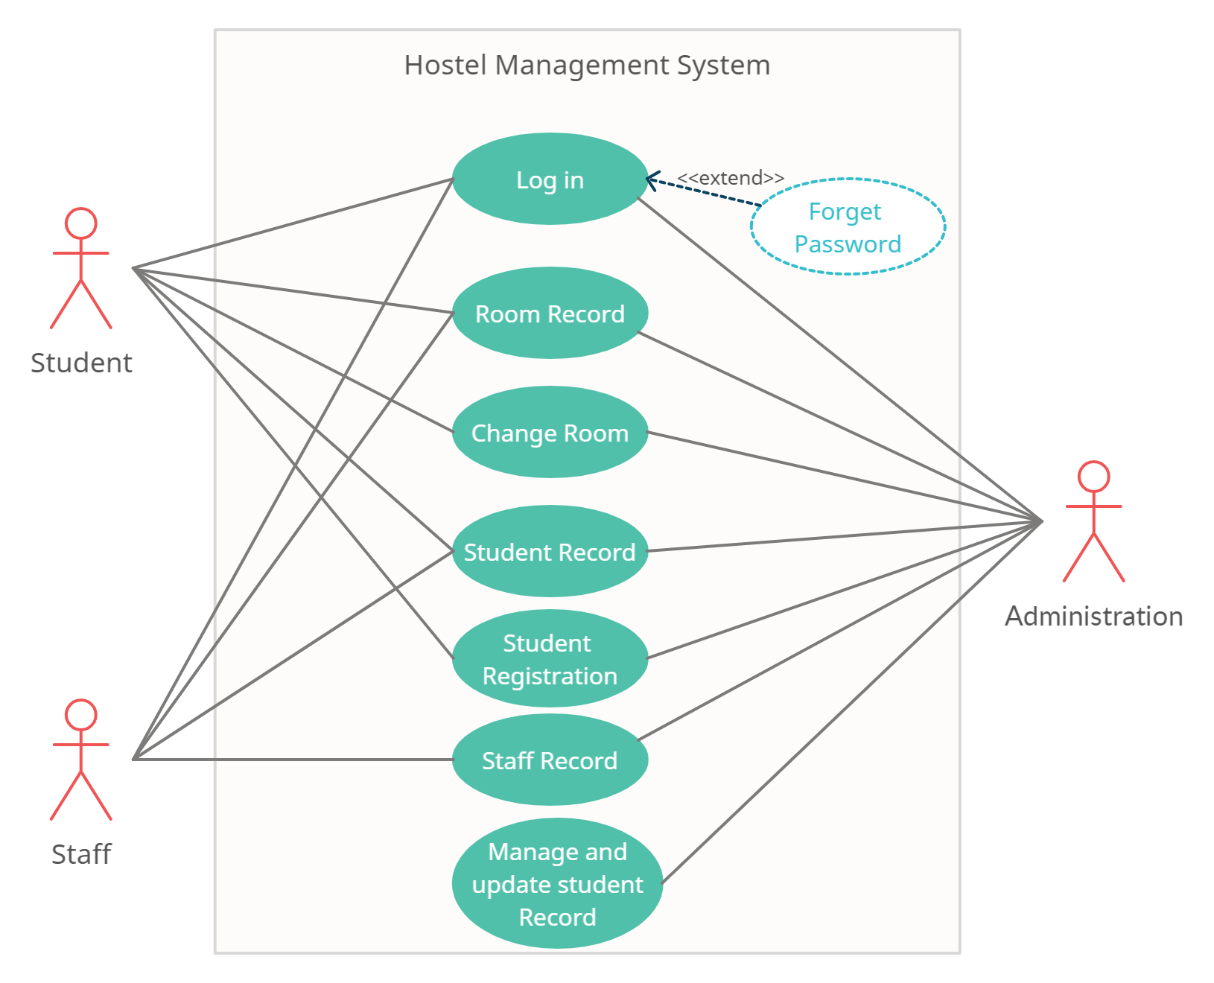
Use Case Diagram

Slide 13
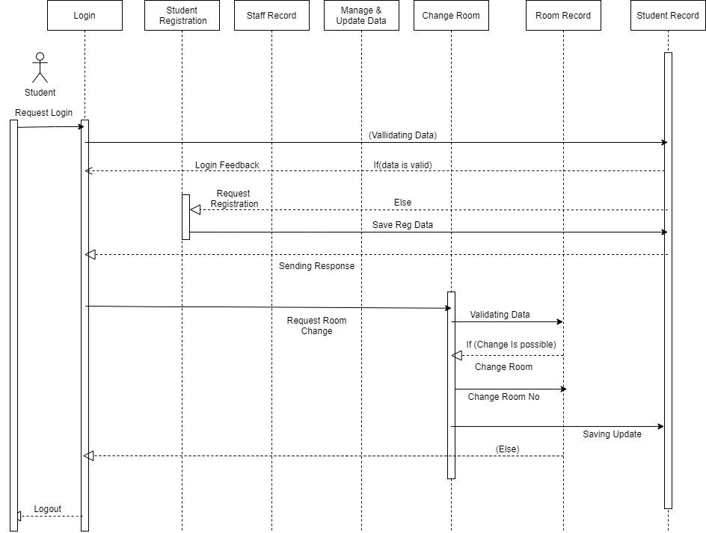
Sequence Diagram(Student)

Slide 14
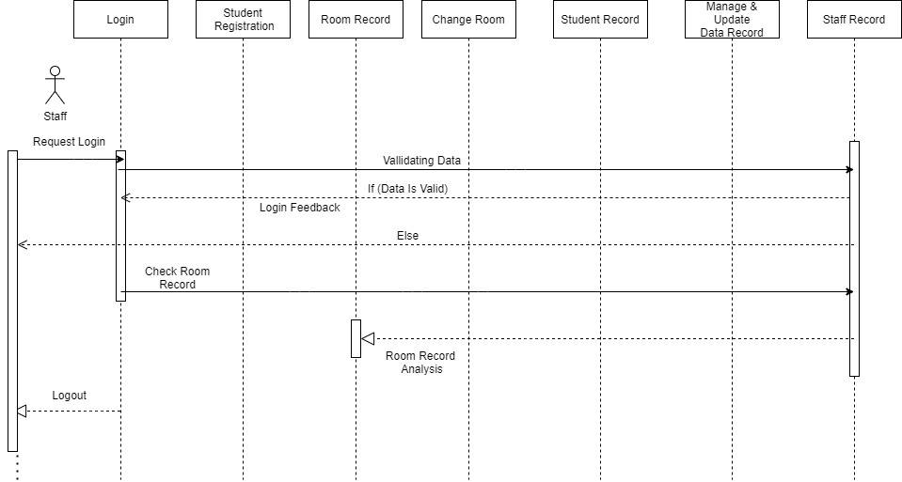
Sequence Diagram(Staff)

Slide 15
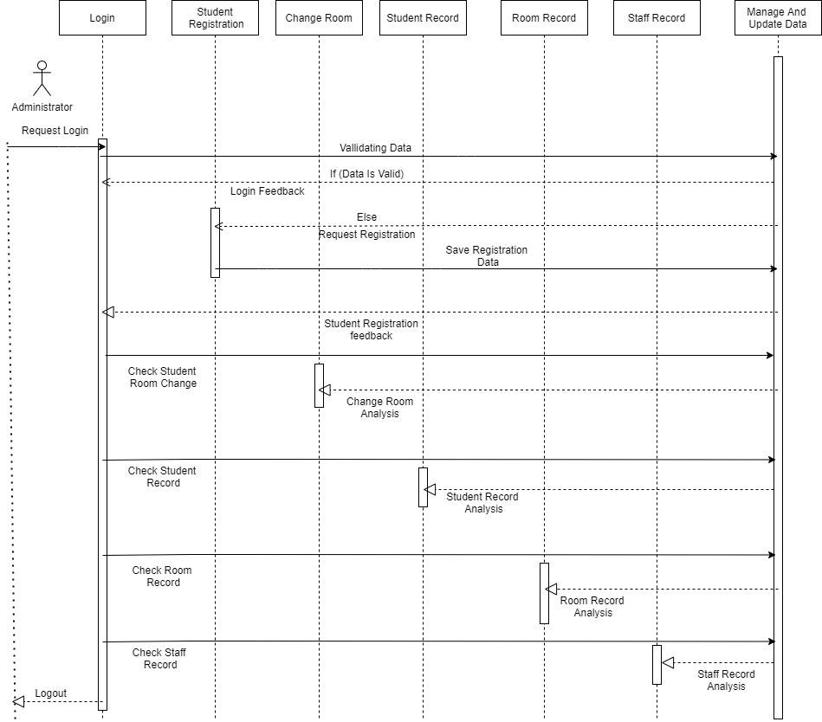
Sequence Diagram(Administration)

Slide 16
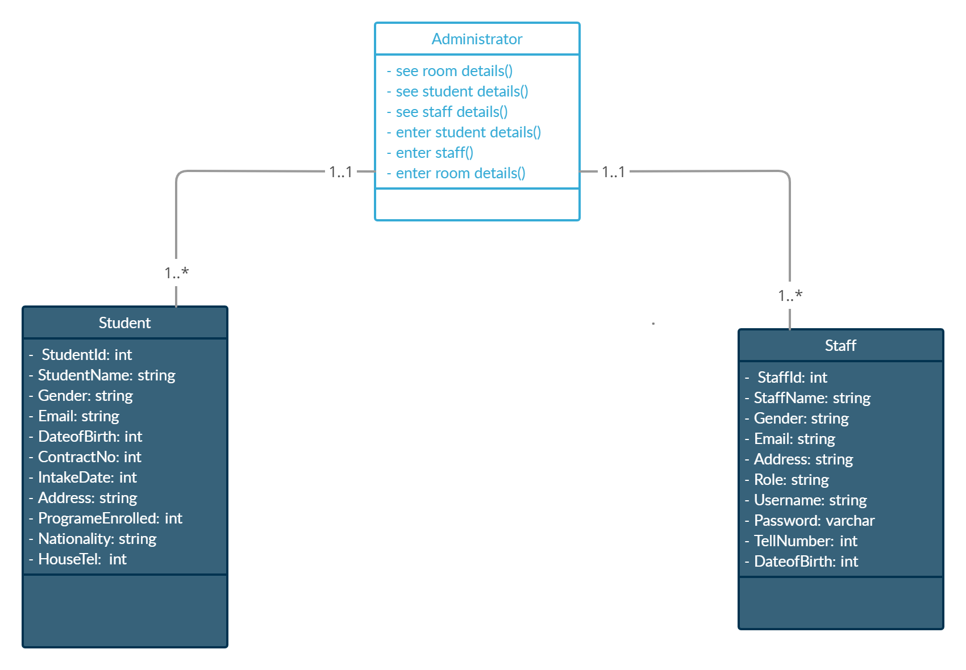
Class Diagram

Slide 17
Assumption and Dependencies
The system must have a user friendly interface that is simple enough for all types of users to understand.
Response time should not be longer than 5 seconds.
A general knowledge of basic computer skills and internet is required to use the system.

Slide 18
Conclusion
.
Hostel Management is a user-friendly and Customization system for student Hostel. It has been developed to manage and automate the over-all processing of any large student hostel.
Hostel management system project is capable of managing hostel rooms, student records and room allocation process etc. It is a user-friendly and customize software for providing support for hostel administration.
This project is a very flexible system and it can be upgraded according to the individual hostel needs.

